Slide 1

Analysis and Prediction of effect of viral diseases in Human + deployment
Group 10

Slide 2
Work-flow
Know the Reason
To specify the flashing side of project
1
Collecting
The 1st process towards our project is to collect the data from online sources. Data preparation by transforming and cleaning we will do here.
2
Understanding
Now to visualize this data. And understanding the flow of diseases in human
3
Prediction
Figuring out how one can get advantage of this with certain constrains.
4
Deployment
At the end building a platform where it is easy for user and data to communicate easily.
5

Slide 3
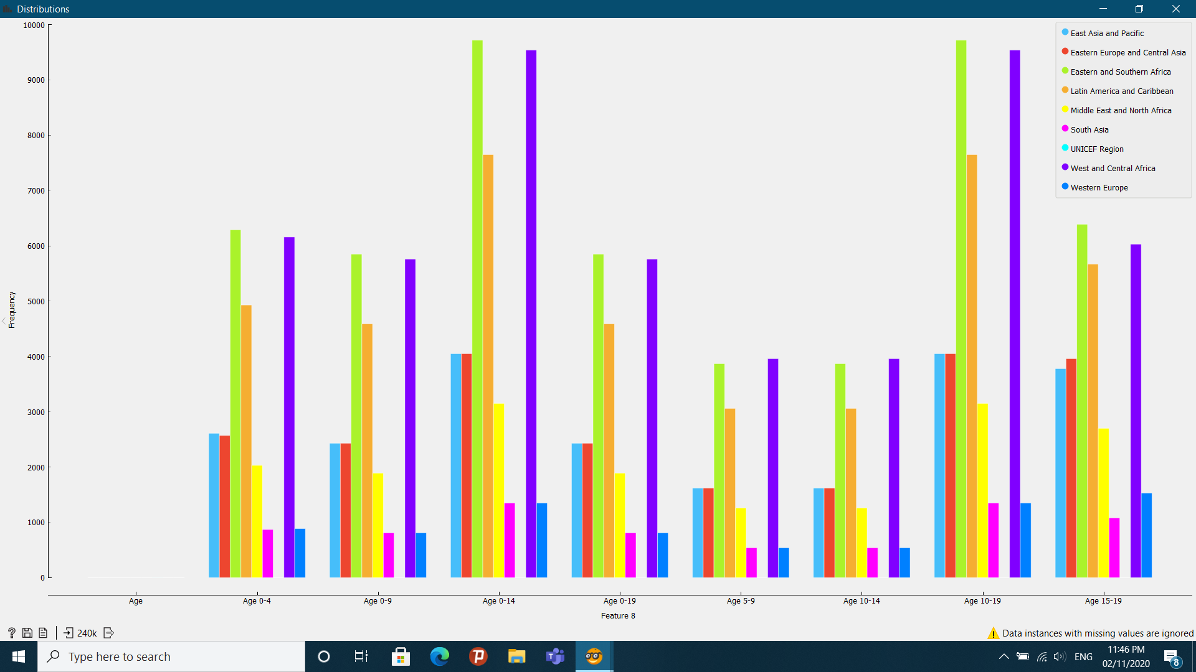
Demo Distributions
Diagram Shows the Distribution of Age group suffering from HIV Infections w.r.t. Region.

Slide 4
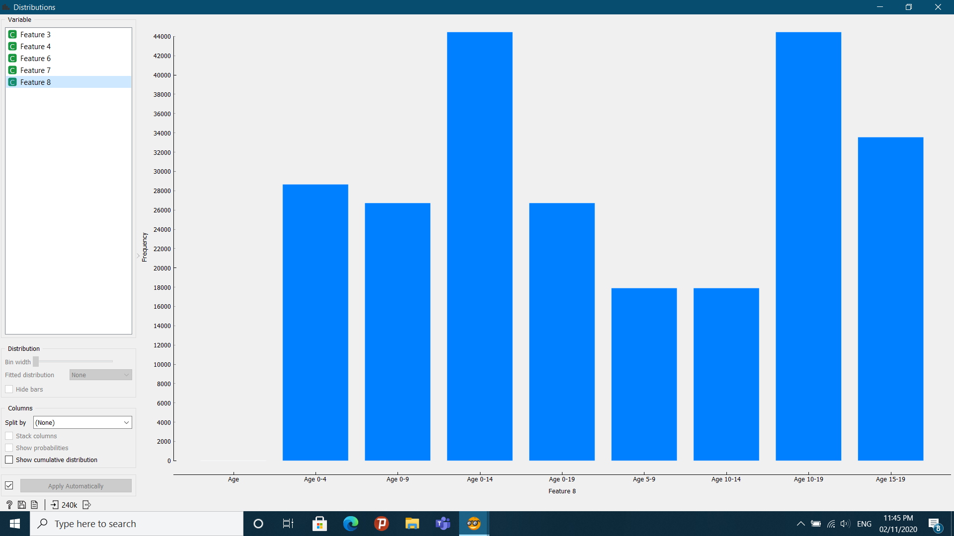
Diagram represents the analysis of Frequency of people suffering from HIV Infections under certain Age groups, as shows this data is the representation of 240k values

Slide 5
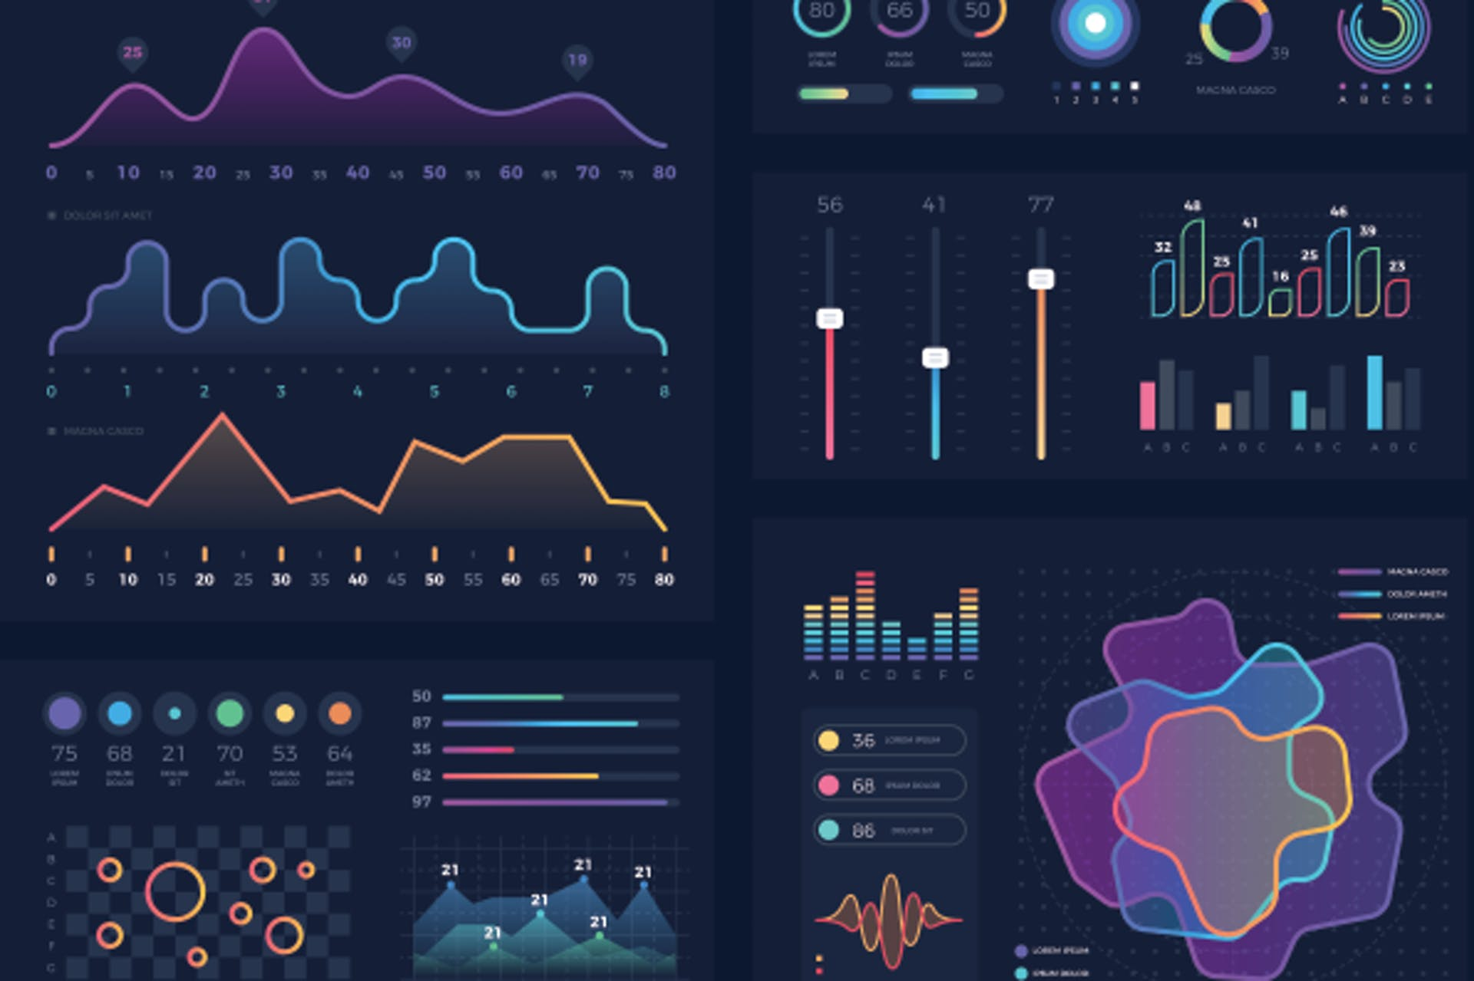
Visualizations
Visualization is a key technology for understanding large datasets.
It is useful throughout the analysis process, for exploratory descriptive analysis, to aid in model building; and for presenting the analysis results.
Our approach to visualizing abstract, non-geometric data involves domain-specific representations, multiple linked views, color, and a highly-interactive user interface using filtering and focusing to reduce visual clutter.
By using visual elements like charts, graphs and maps, data visualization tools provide an accessible way to see and understand trends, outliers, and patterns in data.

Slide 6
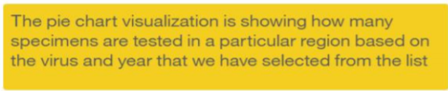
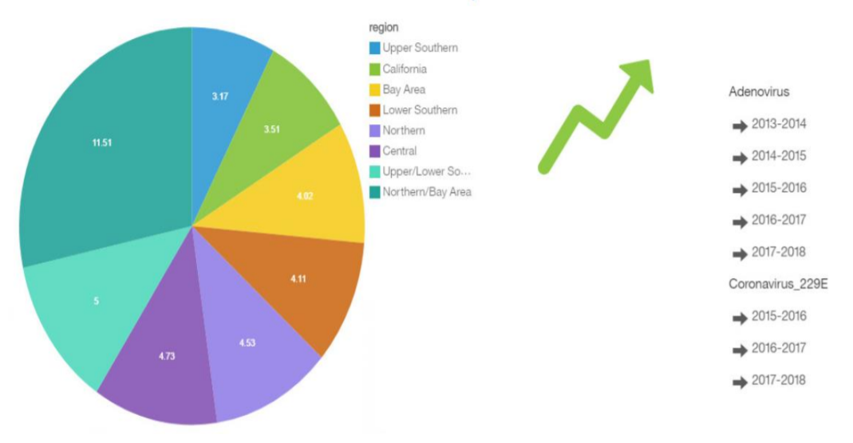
Research on influenza virus

Slide 7
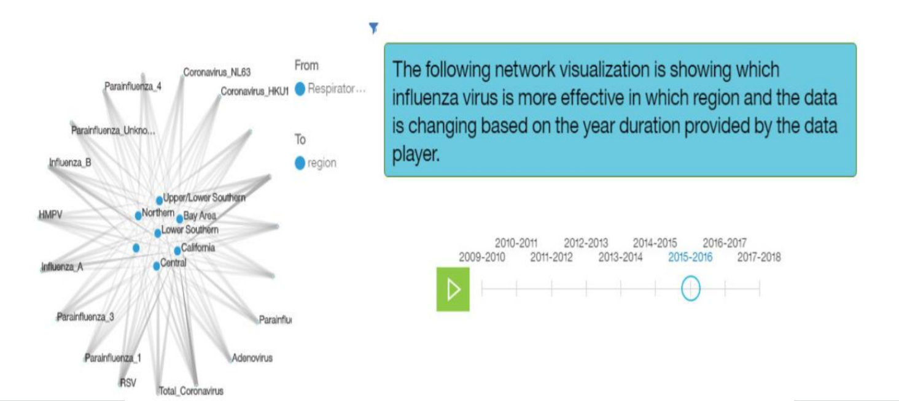
Research on Influenza Virus

Slide 8
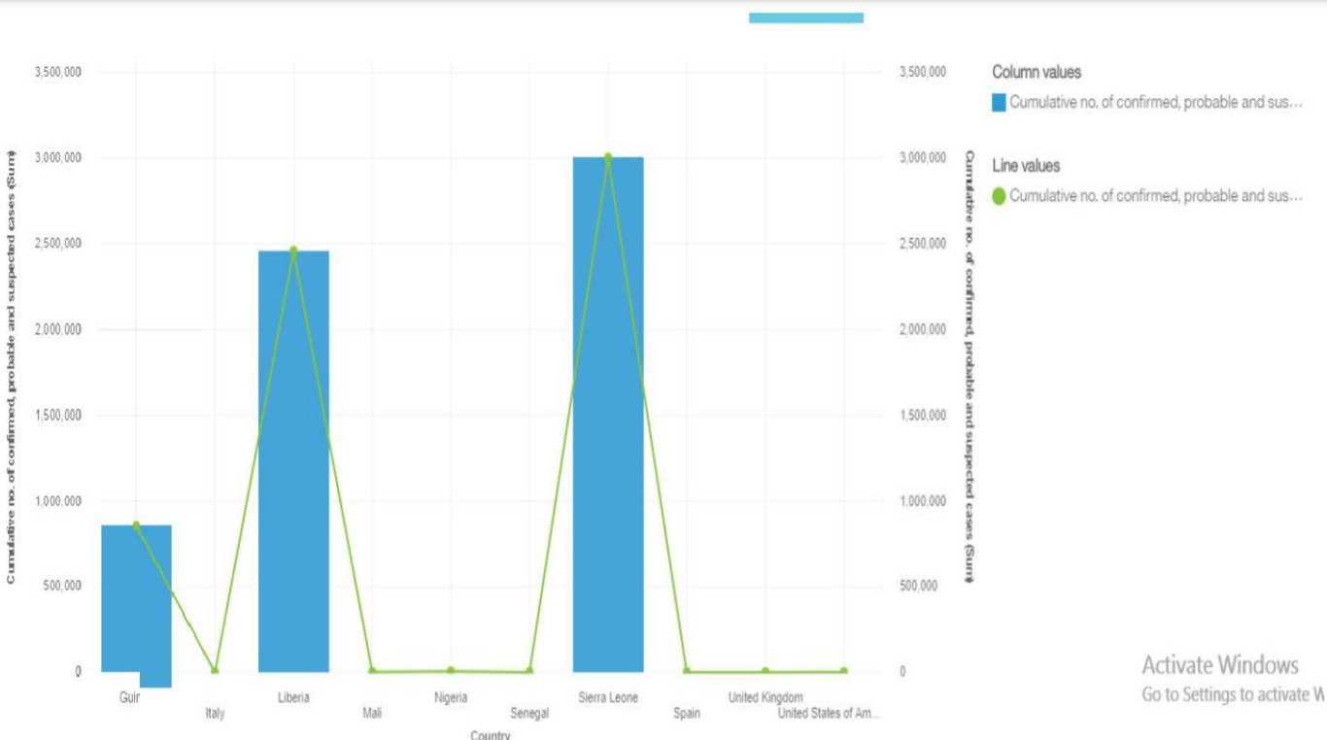
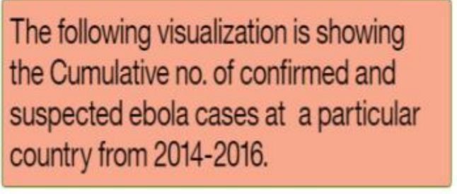
Research on Ebola Virus

Slide 9
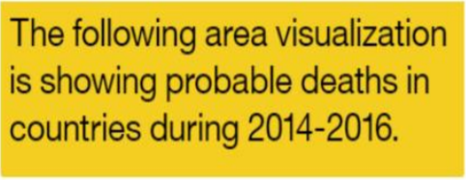
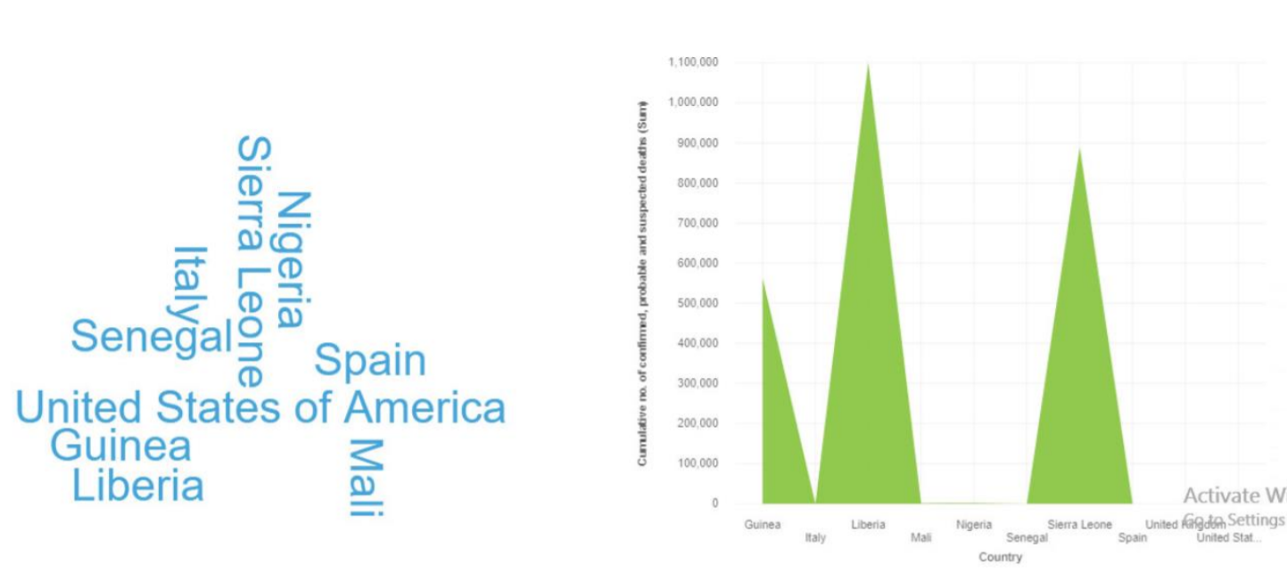
Research on Ebola Virus

Slide 10
Statistical Research and analysis on covid-19 cases
BASED ON DATA SOURCED FROM KAGGLE​

Slide 11
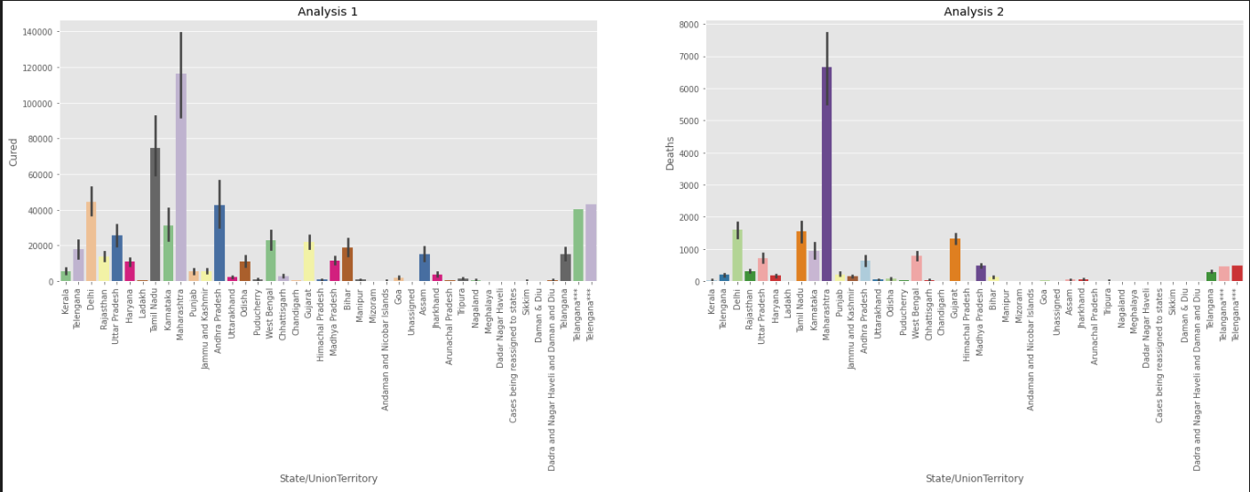
This analysis shows the correlation between the recovered/cured cases and the number of deaths in different states of India. As the number of cured cases increases, so does the number of deaths.

Slide 12
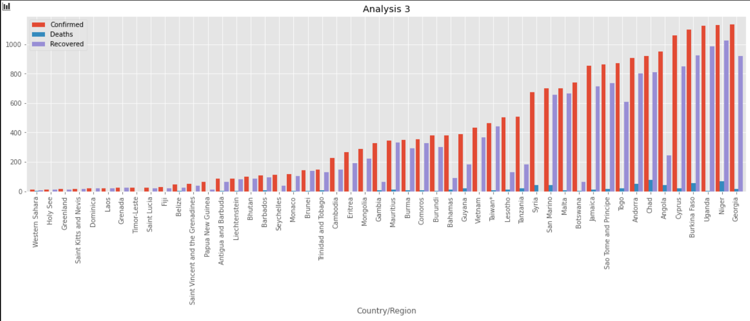
This graph here shows the division of confirmed cases and the recoveries and deaths in different countries.

Slide 13
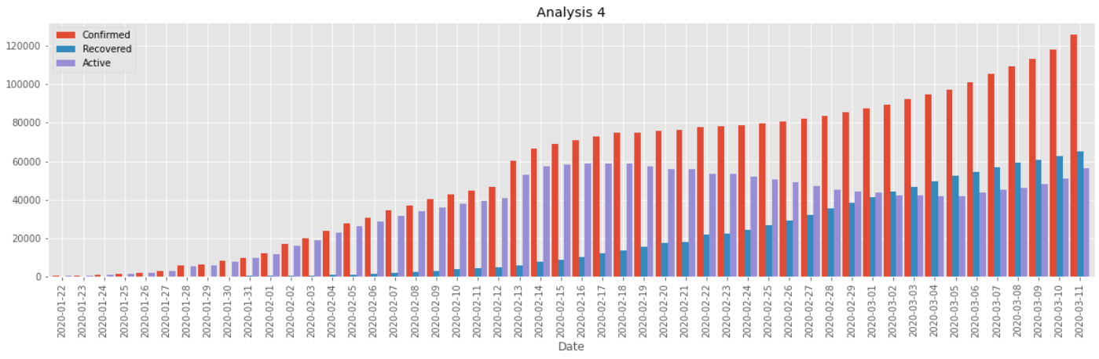
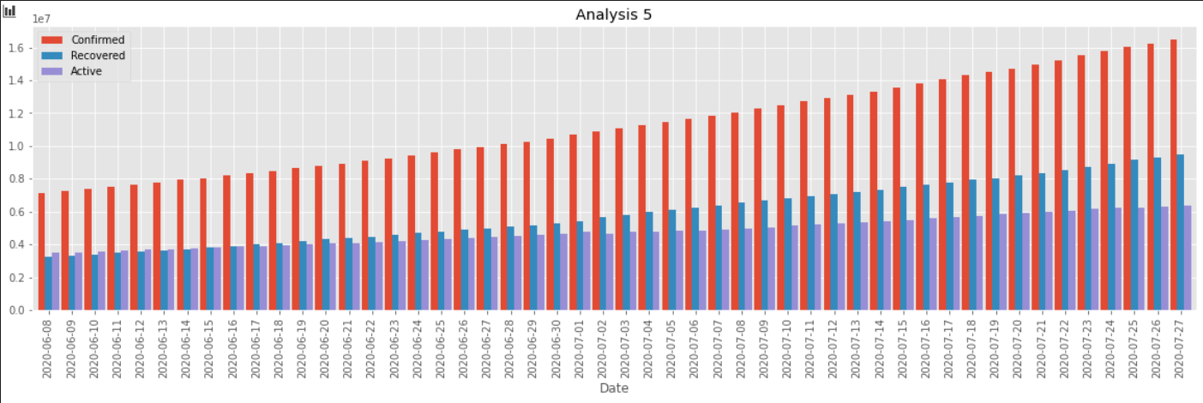
This graphical representation of the number of confirmed, recovered, and active cases in the beginning of the considered period vs the end shows the changes in the proportion of the recovered and active cases.
Initially, the active cases greatly outnumber the recovered cases but by the end the number of recovered cases is more than the active cases.

Slide 14
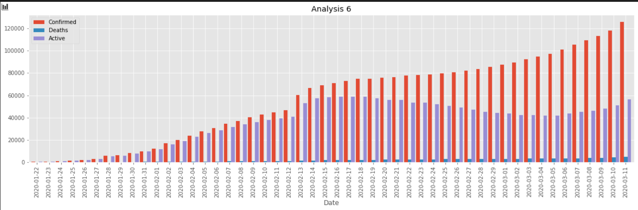
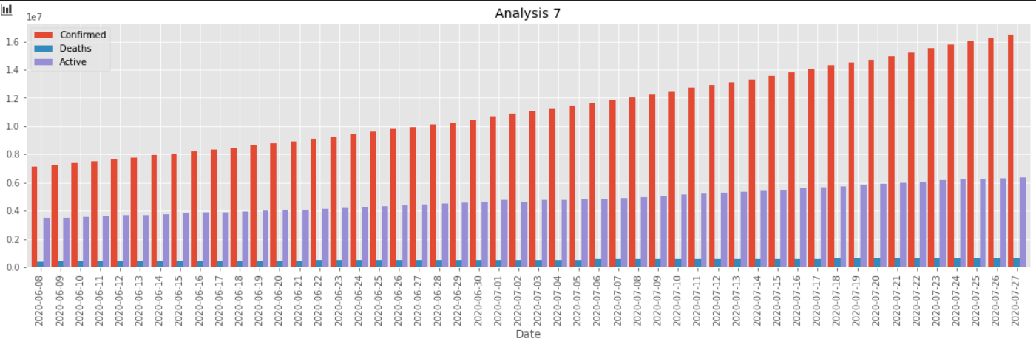
This graphical representation of the number of confirmed cases, deaths and active cases in the beginning of the considered period vs the end shows the changes in the proportion of the deaths and active cases.
The proportion of deaths remains very small from beginning till end.
The proportion of active cases is very high initially, almost equalling the confirmed cases, but over time this proportion reduces as rate of recovery increases and by the end less than 50% of the confirmed cases are active.

Slide 15
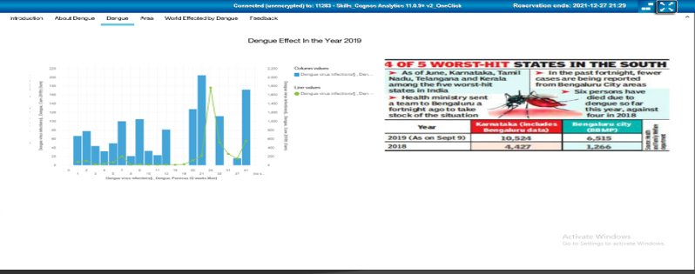
Analysis and visualization Of DENGUE

Slide 16
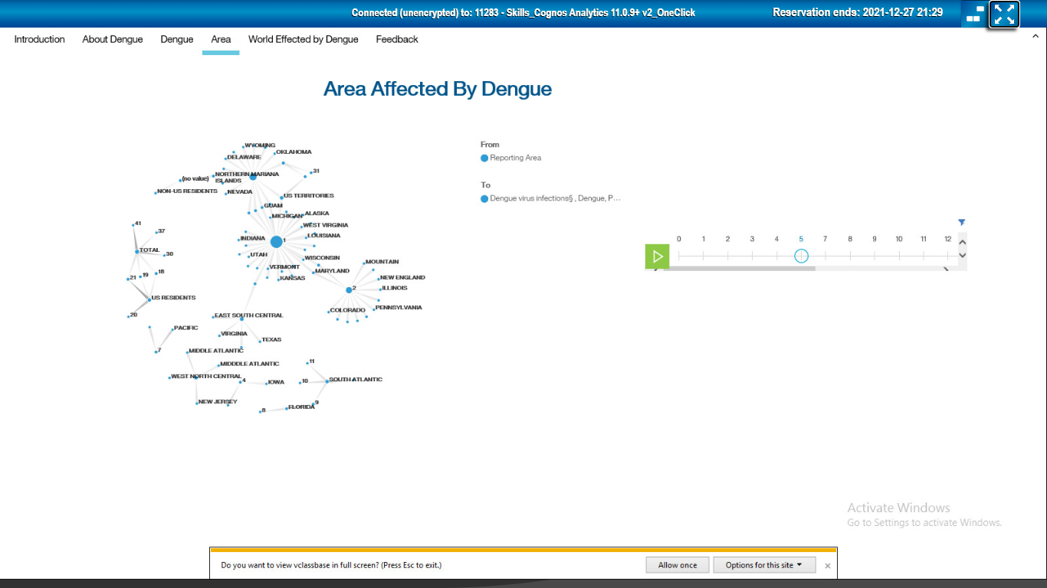

Slide 17
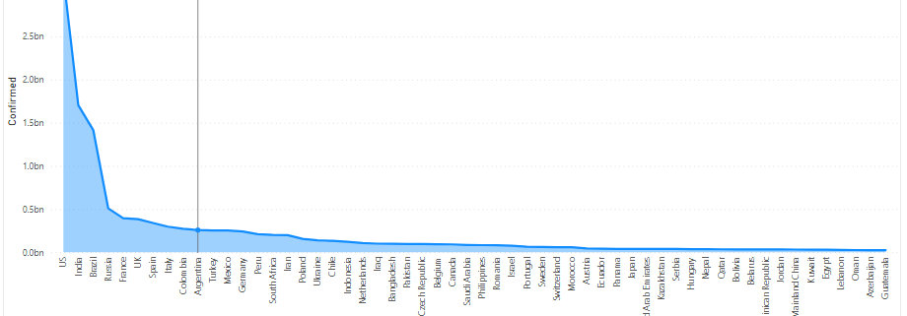
Confirmed Cases

Slide 18
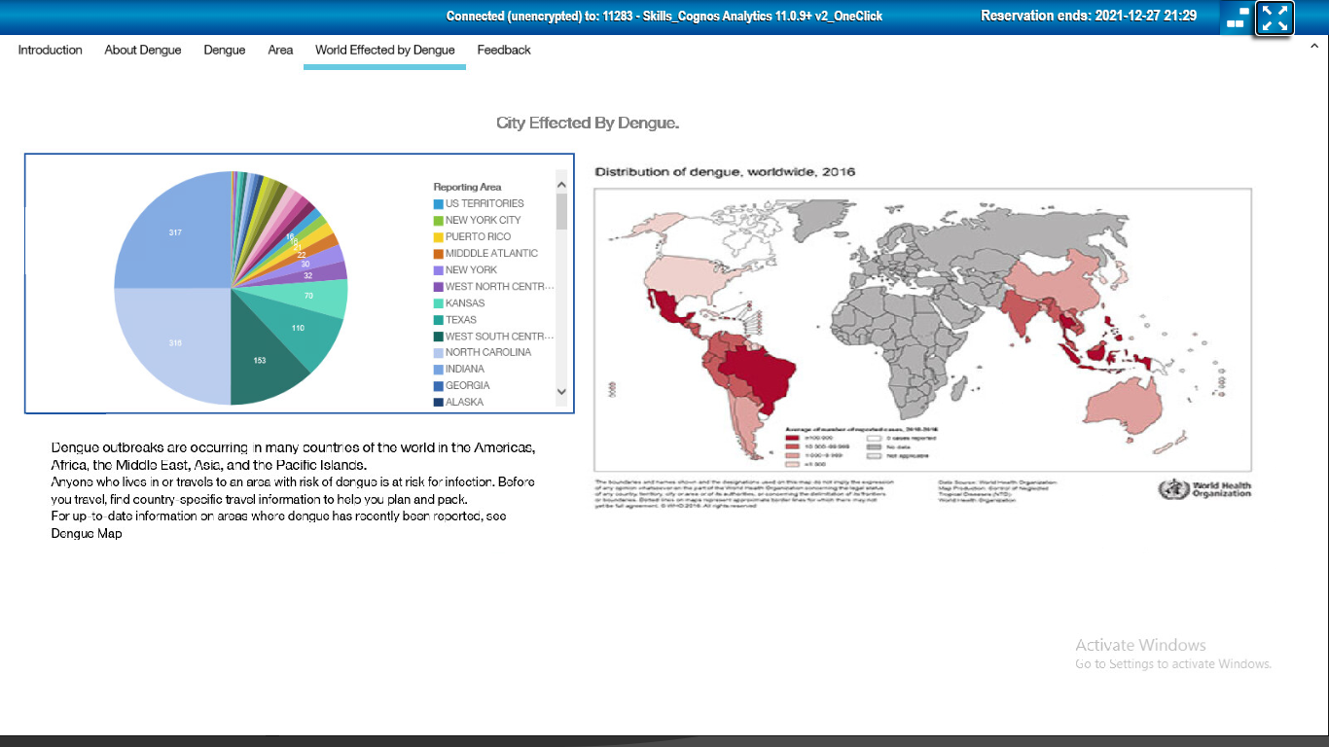

Slide 19
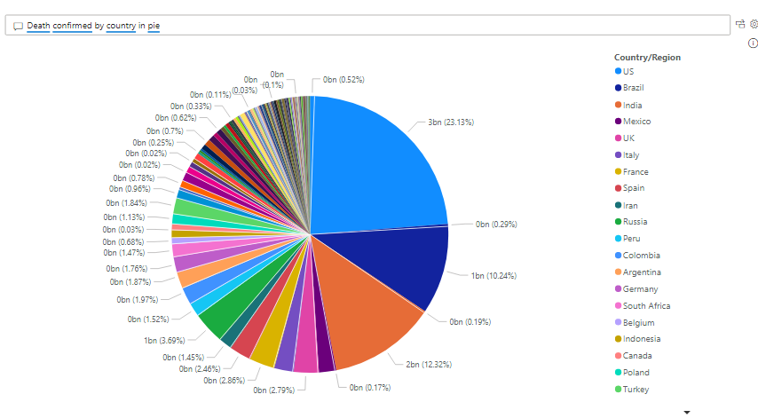

Slide 20
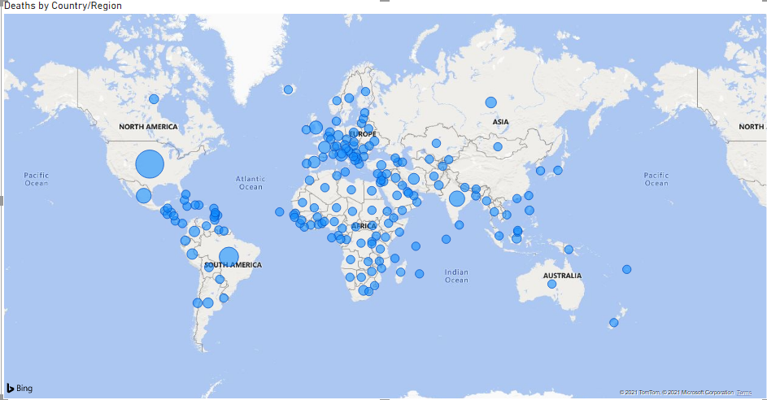

Slide 21
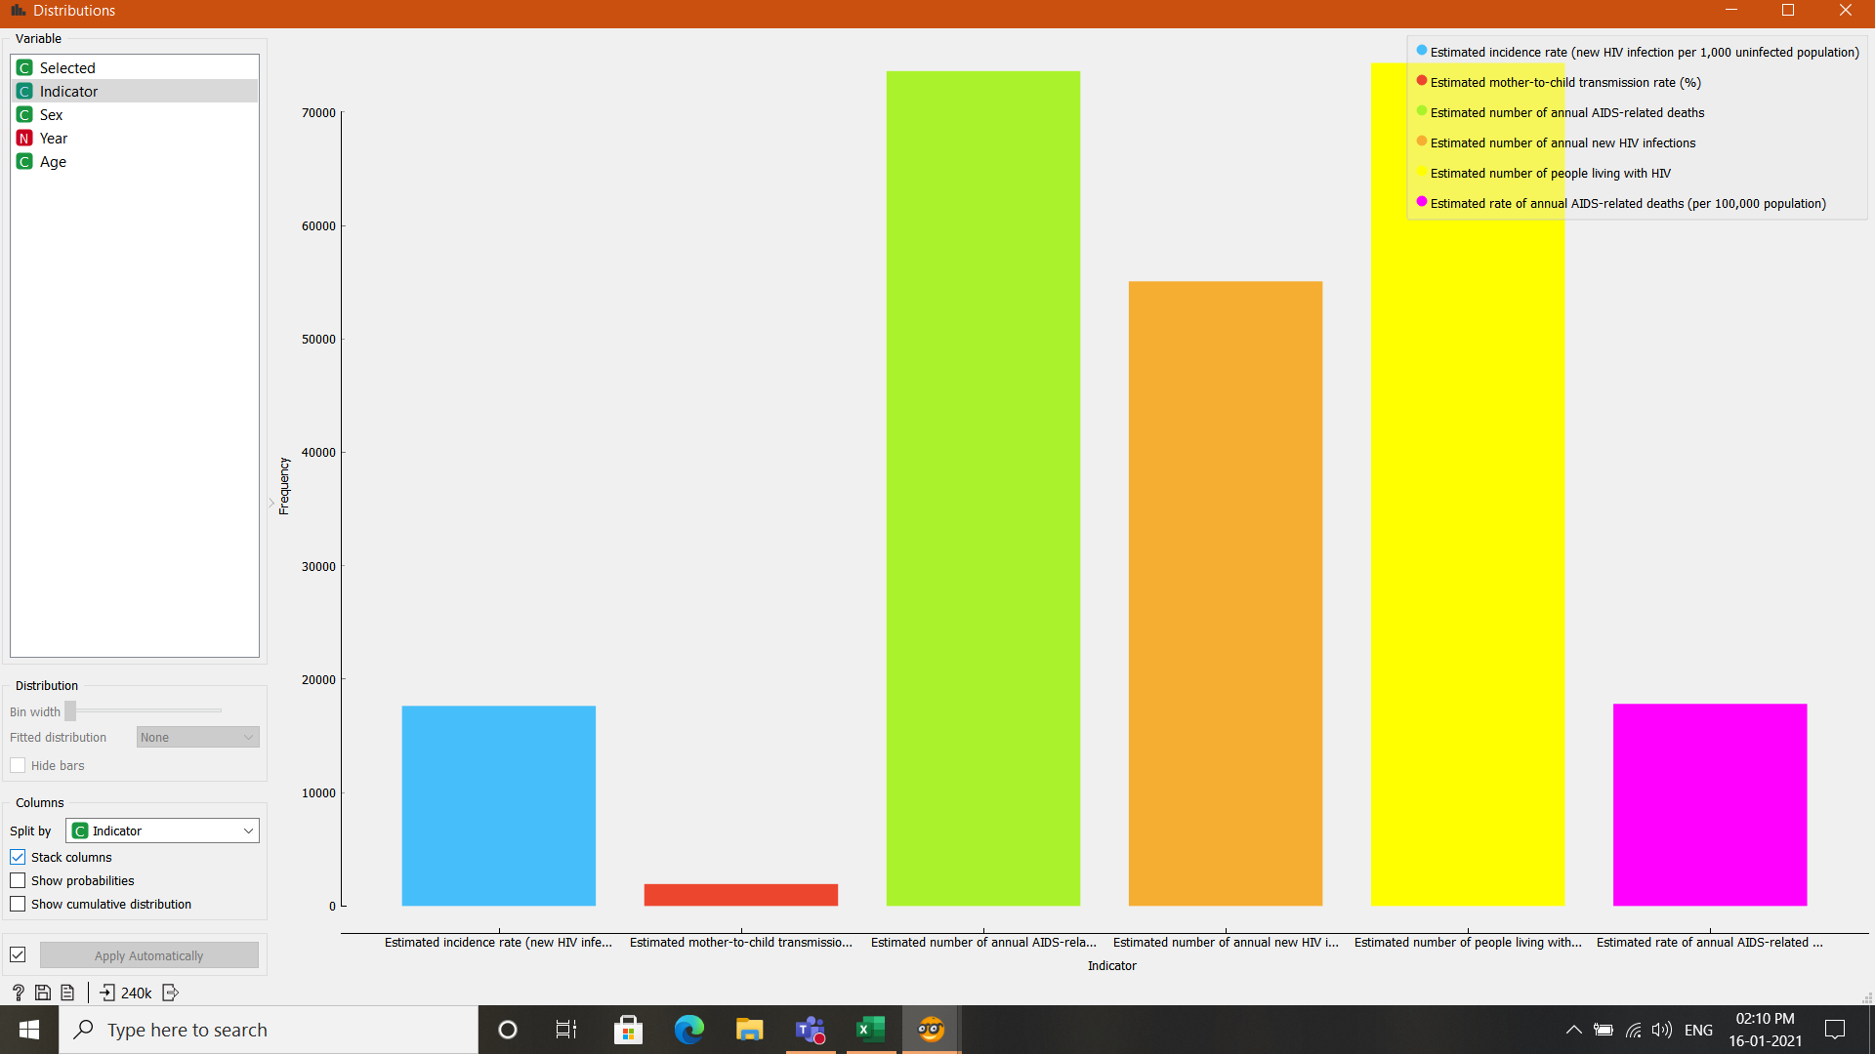
HIV Distribution of Estimated rates representing objects.
The study from the Blue and Orange Bar is of People suffering from other infections(Orange Bar) to that of per 1000 unaffected People.
Number of People living with AIDS was as High as AIDS Related Death.
Conclusion: People Suffering from AIDS Has a very high chance of not Surviving.
Notes:
HIV Distribution of Estimated rates representing objects. Number of People living with AIDS was as High as AIDS Related Death. So we can conclude that People Suffering from AIDS Has a very high Chance of not Surviving.

Slide 22
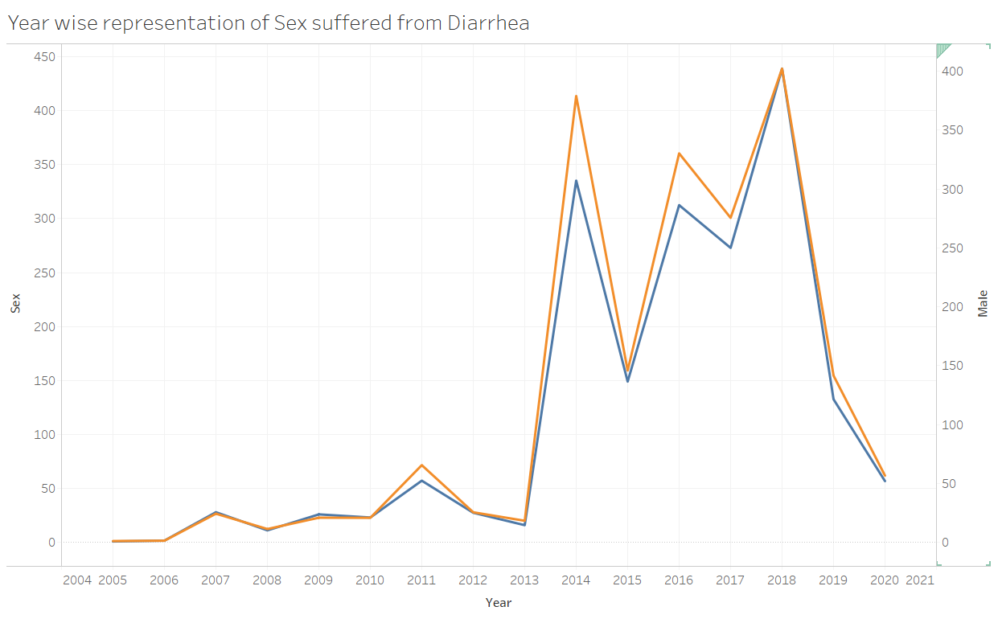
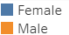
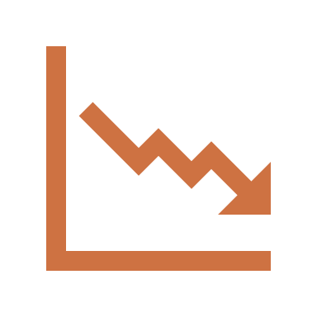

Representation of Comparative study between Males and females suffering from Diarrhoea.
The number of Cases increases Heavily in Year 2013-14, 2015-16 and 2017-18.
Conclusion: There’s not very large difference between the Ratio of Males and Females.
Notes:
Representation of count of males to the ratio of female cases suffering from Diarrhoea: they are Nearly Same. But we see that it increases heavily on 2013,2015,2017.

Slide 23
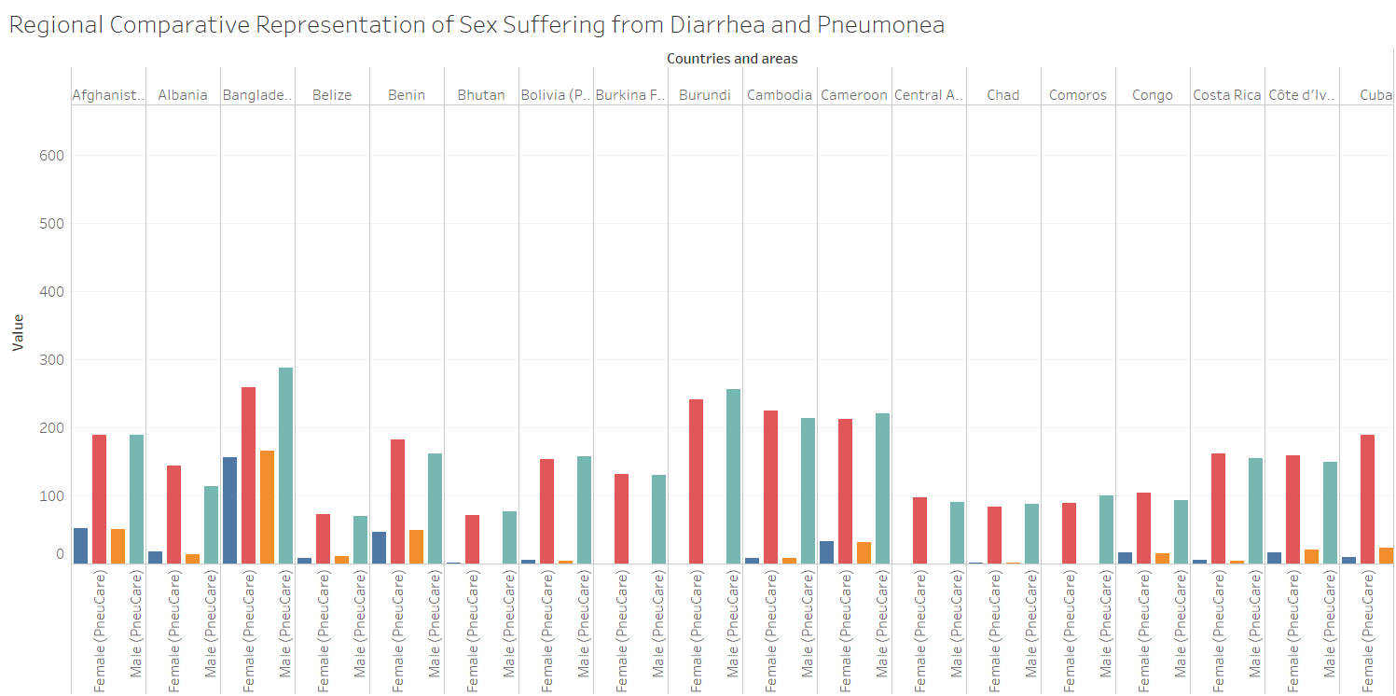
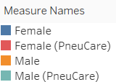

Slide 24
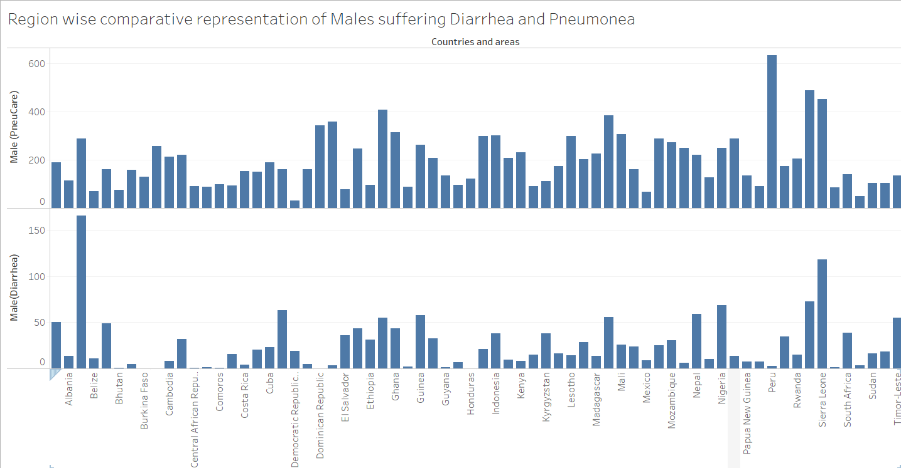
Notes:
Comparative representation showing the region’s males suffered from Diarrhoea and Pneumonia. Region like Peru have minimal cases of Male Diarrhoea and vice versa with Male Pneumonia from the year 2009.

Slide 25
Next steps
We have successfully completed Phase 1 and now we are entering to Phase 2.
So far we have completed our Data’s collection, its Refining and Visualization that help us understood ill-effects of these diseases on human civilization.
Further we will now implement Prediction models using Supervised Learning Approach.
Data Collection
World Data Warehouse
Data lookup
Data Understanding
Refining
Visualization
Data Prediction
Understanding
Learning Algos

Slide 26
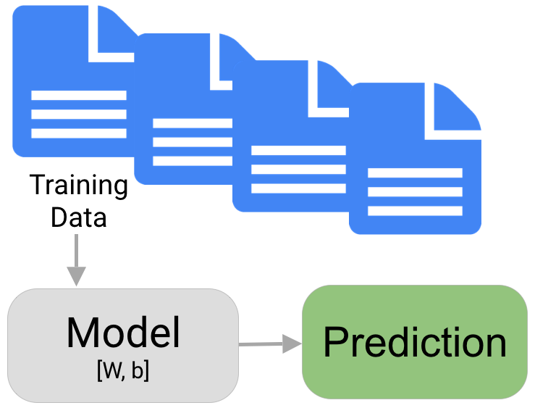
Predictions using datasets
A prediction is a statement about the future. It’s a guess, sometimes based on facts or evidence

Slide 27
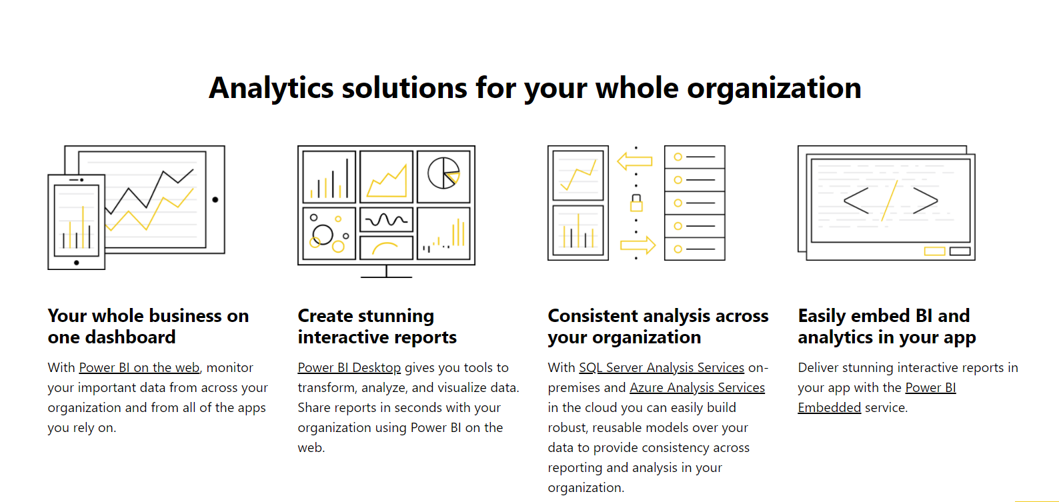
Why power bi?
In Power Bi we can apply predictive forecasting, and hindcasting, when visualizing and exploring the data. Forecasting in Power View utilizes built-in predictive forecasting models using exponential smoothing to automatically detect seasonality in the data to provide forecast results from a series of data. Explore forecast results by adjusting the desired confidence interval or by adjusting outlier data to see how they affect results. We can also hindcast to see how Power View would have predicted the present and recent past based on older data.
The best data for forecasting is time series data or uniformly increasing whole numbers. The line chart has to have only one line. Multiple-line charts won’t work, even if all but one line is filtered out

Slide 28

UNSUPERVISED LEARNING
Data clustering is an unsupervised classification method (different from supervised classification where learning data is already tagged)
Association Rule Learning is to discover relationships of interest to the statistician between two or more variables stored in very large databases using association rule search algorithms.

Slide 29
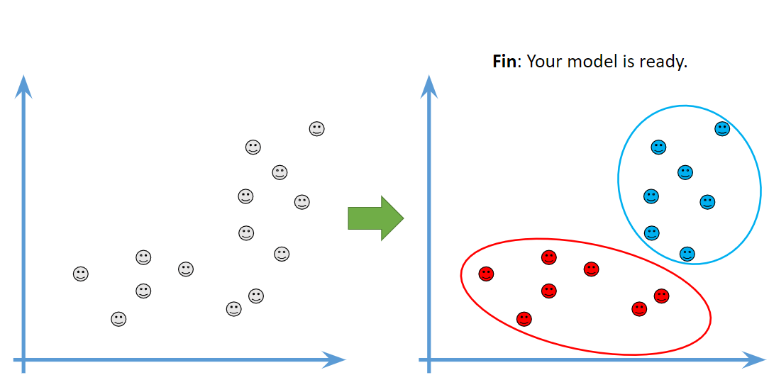
Understanding K-Means

Slide 30
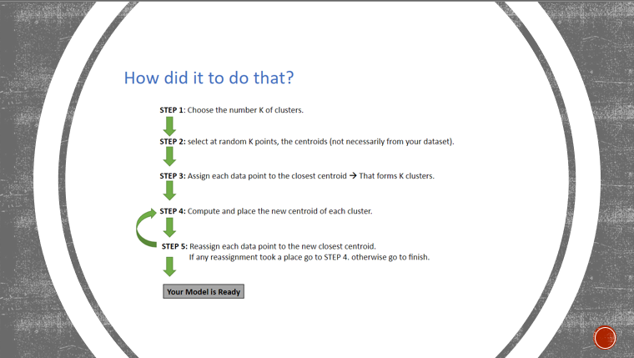

Slide 31
What is Apriori ?
Apriori is an algorithm for frequent item set mining and association rule learning over transactional databases.
It proceeds by identifying the frequent individual items in the database and extending them to larger and larger item sets if those item sets appear sufficiently often in the dataset.

Slide 32
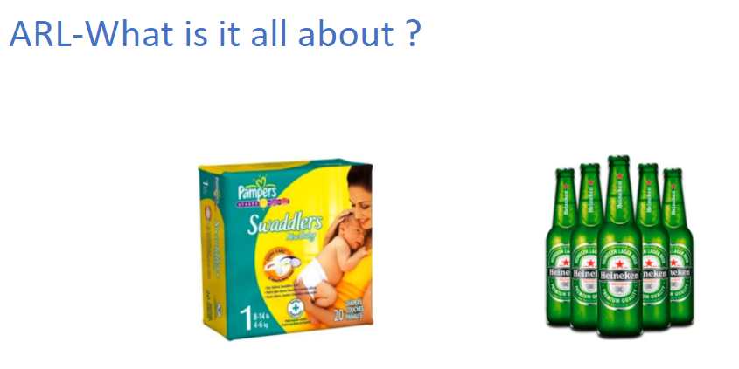
What is it all about ?

Slide 33
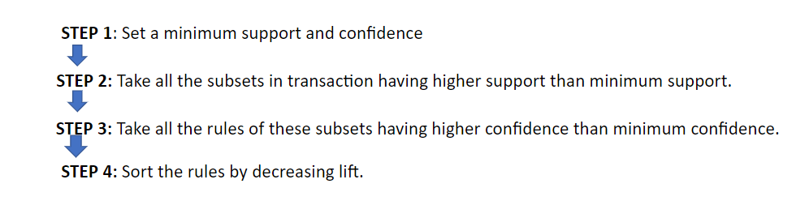
Apriori Algoritghm
Apriori Algoritghm

Slide 34

Prediction Models
Phase 2

Slide 35
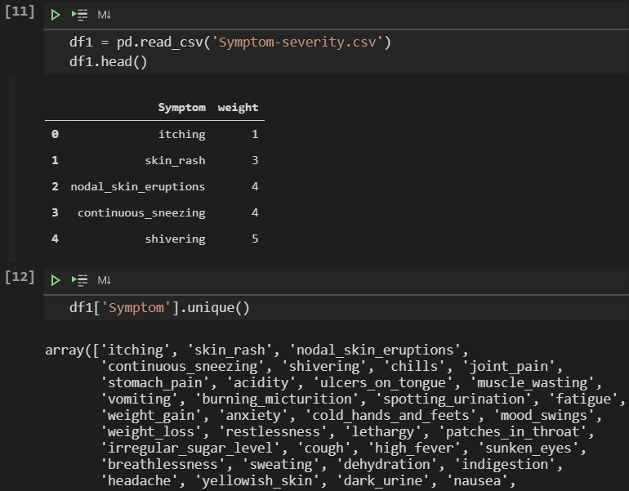
Disease Prediction model review & Accuracy
Reading the weights of symptoms to identify the frequency of sample symptoms in most of the Diseases.
Checking for symptoms present in our dataset.

Slide 36
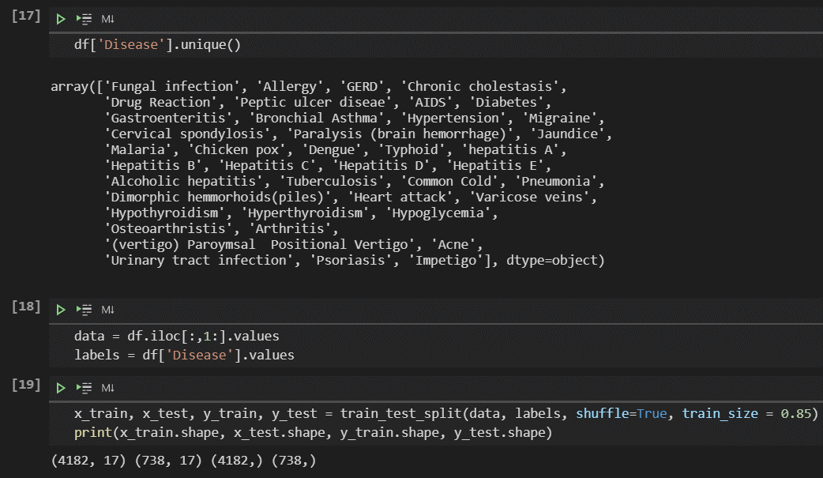
Getting started with Prediction
Getting an overview of number of diseases in dataset and accordingly assigning the disease names to labels for prediction.
Finally Splitting the data in the ratio of
(85 : 15)
(train : test)

Slide 37
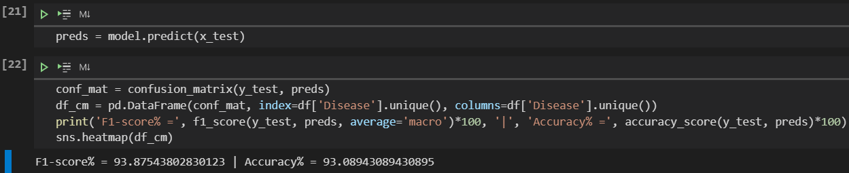
Model’s accuracy
Finally training model and predicting the Test set using SVC (Support Vector Classifier)
Our model’s accuracy comes out to be 93%.
To understand the balance between precision and recall we calculated F1 Score that turned out to be 93.8%. The Concludes that most of the Actual True Positive Values were predicted True Positive and Similarly for the other one.

Slide 38
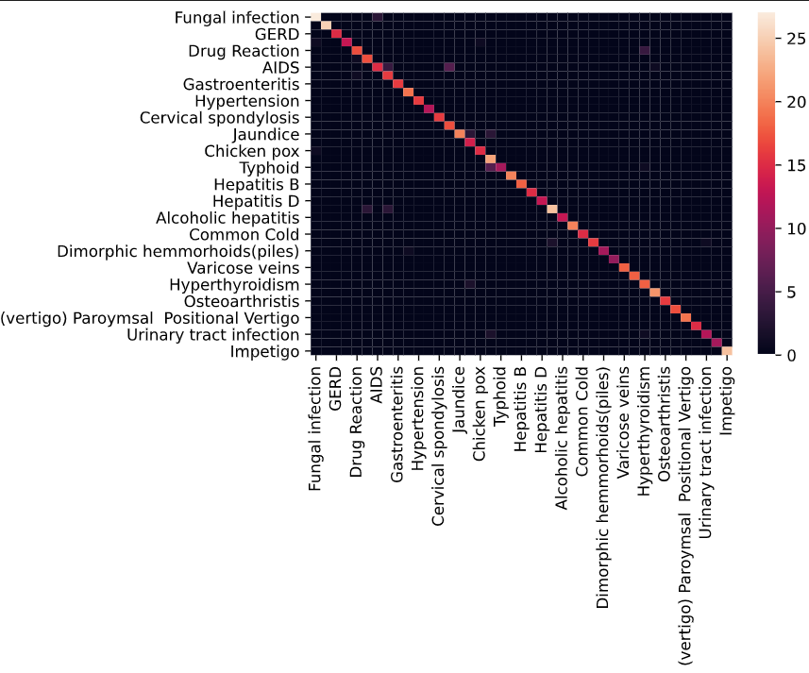

Slide 39
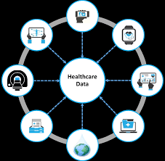
DISEASE PREDICTION USING MACHINE LEARNING
The classical diagnosis method is a process where the patient has to visit a doctor, undergo various medical tests, and then come to a conclusion. This process is very time-consuming.
To save time required for the initial process of diagnosis symptoms, this project proposes an automated disease prediction system that relies on user input.
The system takes input from the user and provides a list of probable diseases.

Slide 40
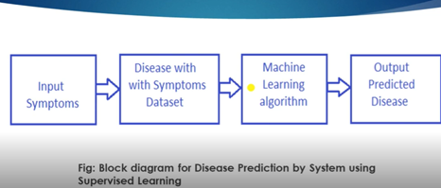
Module description :
The system will predict the disease where the symptoms are given as the input.
The disease will be predicted using the Naive Bayesian algorithm.
According to the literature survey, this algorithm results in the maximum accuracy for a larger dataset.
The dataset contains disease as labels and for each disease, symptoms are given. 70% of the dataset will be used as training and 30% will be used for training data.
Training and testing would be done on the dataset and the desired output will be obtained.

Slide 41
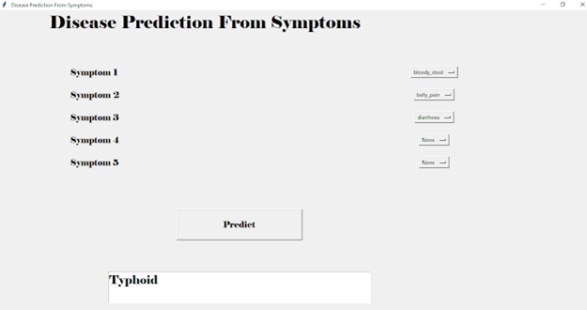
GUI :
We have used the Tkinter package for the User interface.
Tkinter is the standard GUI library for python.
Python, when combined with Tkinter, provides a fast and easy way to create a GUI application.
Tkinter provides a powerful object-oriented interface to the Tk GUI toolkit.

Slide 42

Result and conclusion :
The project is designed in such a way that the system takes symptoms from the user as input and produces output i.e. predict disease.
The user can select a minimum of one to a maximum of five symptoms.
Less accuracy will be attained if only one symptom is entered. More the number of symptoms, the greater is the accuracy.

Slide 43

Few new Libraries Used
Folium: folium builds on the data wrangling strengths of the Python ecosystem and the mapping strengths of the leaflet.js library. Manipulate your data in Python, then visualize it in on a Leaflet map via folium.
Calmap: Plot Pandas time series data sampled by day in a heatmap per calendar year, like GitHub’s contributions plot, using matplotlib.

Slide 44
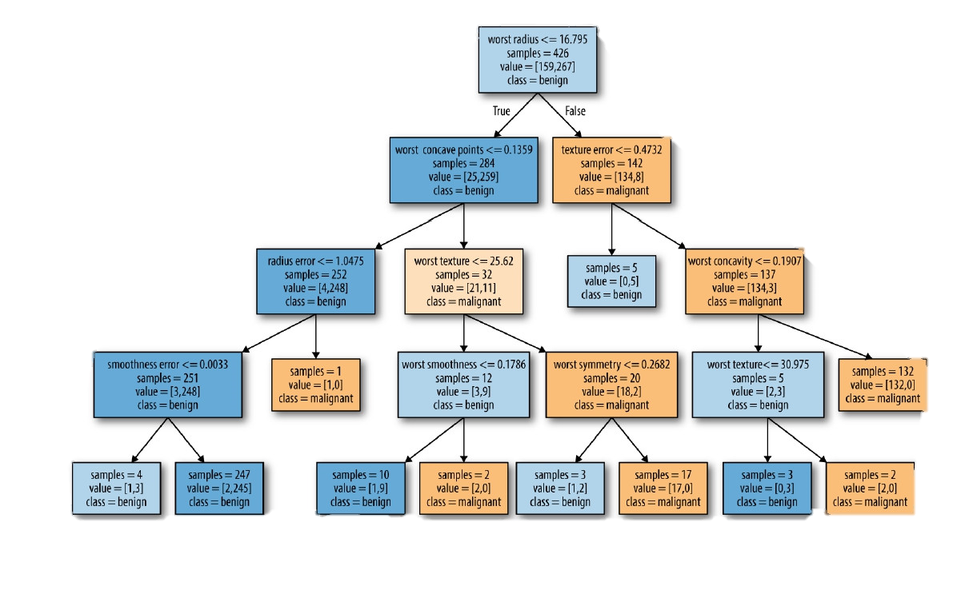
Decision TRee
Decision Trees are the building blocks of the supervised learning methods.
Decision tree is a Binary tree flowchart.
Each node splits a group of observations, according to some feature variable.
Decision tree can be used to approximate a continuous target variable.
Here, tree splits such that each group has the lowest mean squared error
Decision Trees are easily interpreted.

Slide 45
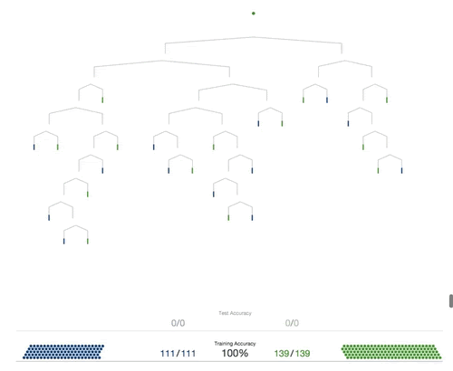
Conclusion
Before neural networks became popular, decision trees were the state of the art algorithm in Machine Learning.
Several other ensemble models like Random Forests are much more powerful than the vanilla decision tree.

Slide 46
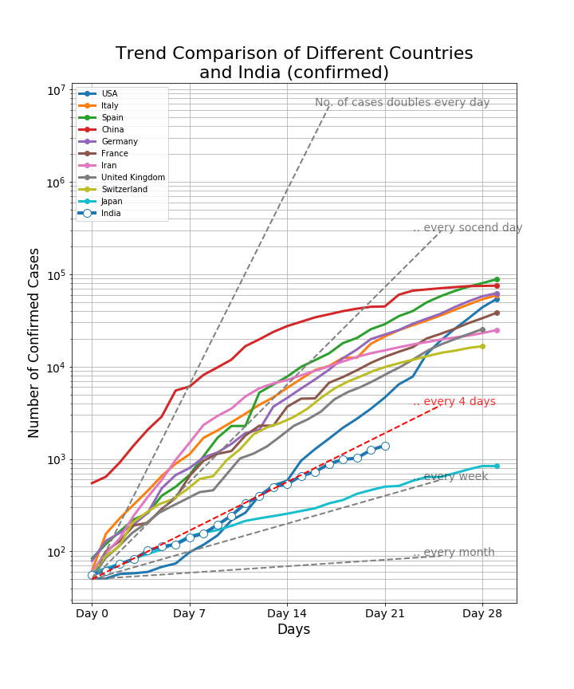
This graph here shows the relation of how the Confirmed cases were increasing in the few major countries on the Globe.

Slide 47
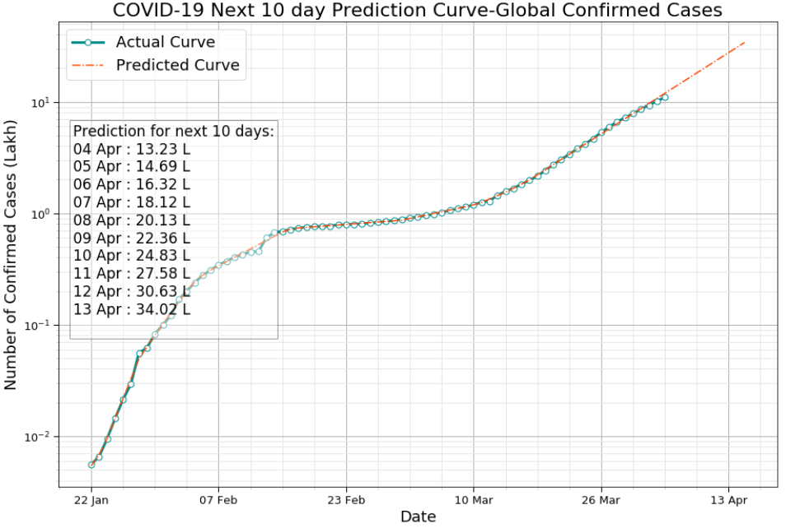
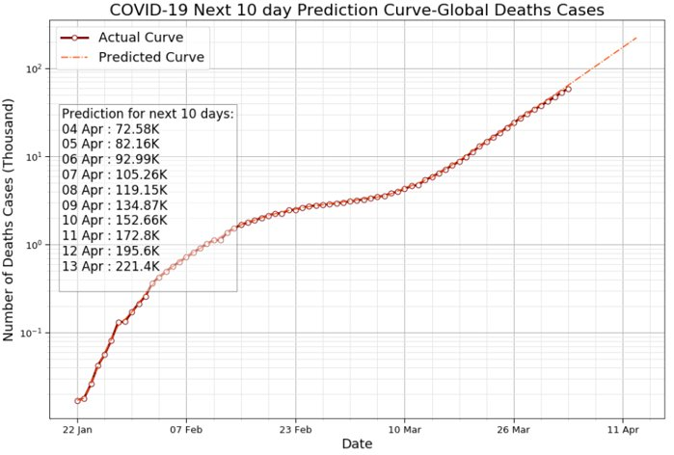
Prediction on Deaths and confirmed cases due to covid-19

Slide 48

Heart DISEASE PREDICTION
Heart disease is the leading cause of death in the world, according to the Centers for Disease Control and Prevention (CDC)Trusted Source. In the United States, 1 in every 4 deaths in is the result of a heart disease. That’s about 610,000 people who die from the condition each year.
Heart disease doesn’t discriminate. It’s the leading cause of death for several populations, including white people, Hispanics, and Black people. Almost half of Americans are at risk for heart disease, and the numbers are rising.

Slide 49
Types of HEART DISEASES
Coronary artery disease is the most common type of heart disease in the US. Coronary arteries supply blood to the heart muscle and coronary artery disease occurs when there is a buildup of cholesterol plaque inside the artery walls. Over time, this buildup of plaque may partially block the artery and decrease blood flow through it.
Congenital heart defects- A person with a congenital heart defect is born with a heart problem. There are many types of congenital heart defect.
Arrhythmia refers to an irregular heartbeat. It occurs when the electrical impulses that coordinate the heartbeat do not work properly. As a result, the heart may beat too fast, too slowly, or erratically.
Dilated cardiomyopathy the heart chambers become dilated, meaning that the heart muscle stretches and becomes thinner. The most common causes of dilated cardiomyopathy are prior heart attacks, arrhythmias, and toxins.

Slide 50
SYMPTOMS of heart DISEASE
The symptoms of heart disease depend on the specific type a person has. Also, some heart conditions cause no symptoms at all.The following symptoms may indicate a heart problem:
angina, or chest pain
difficulty breathing fatigue and lightheadedness and swelling due to fluid retention, or edema
In children, the symptoms of a congenital heart defect may include cyanosis, or a blue tinge to the skin, and an inability to exercise.
Some signs and symptoms that could indicate heart attack include:
Sweating, arm, jaw, back, or leg pain
a choking sensation
swollen ankles , fatigue
an irregular heartbeat

Slide 51
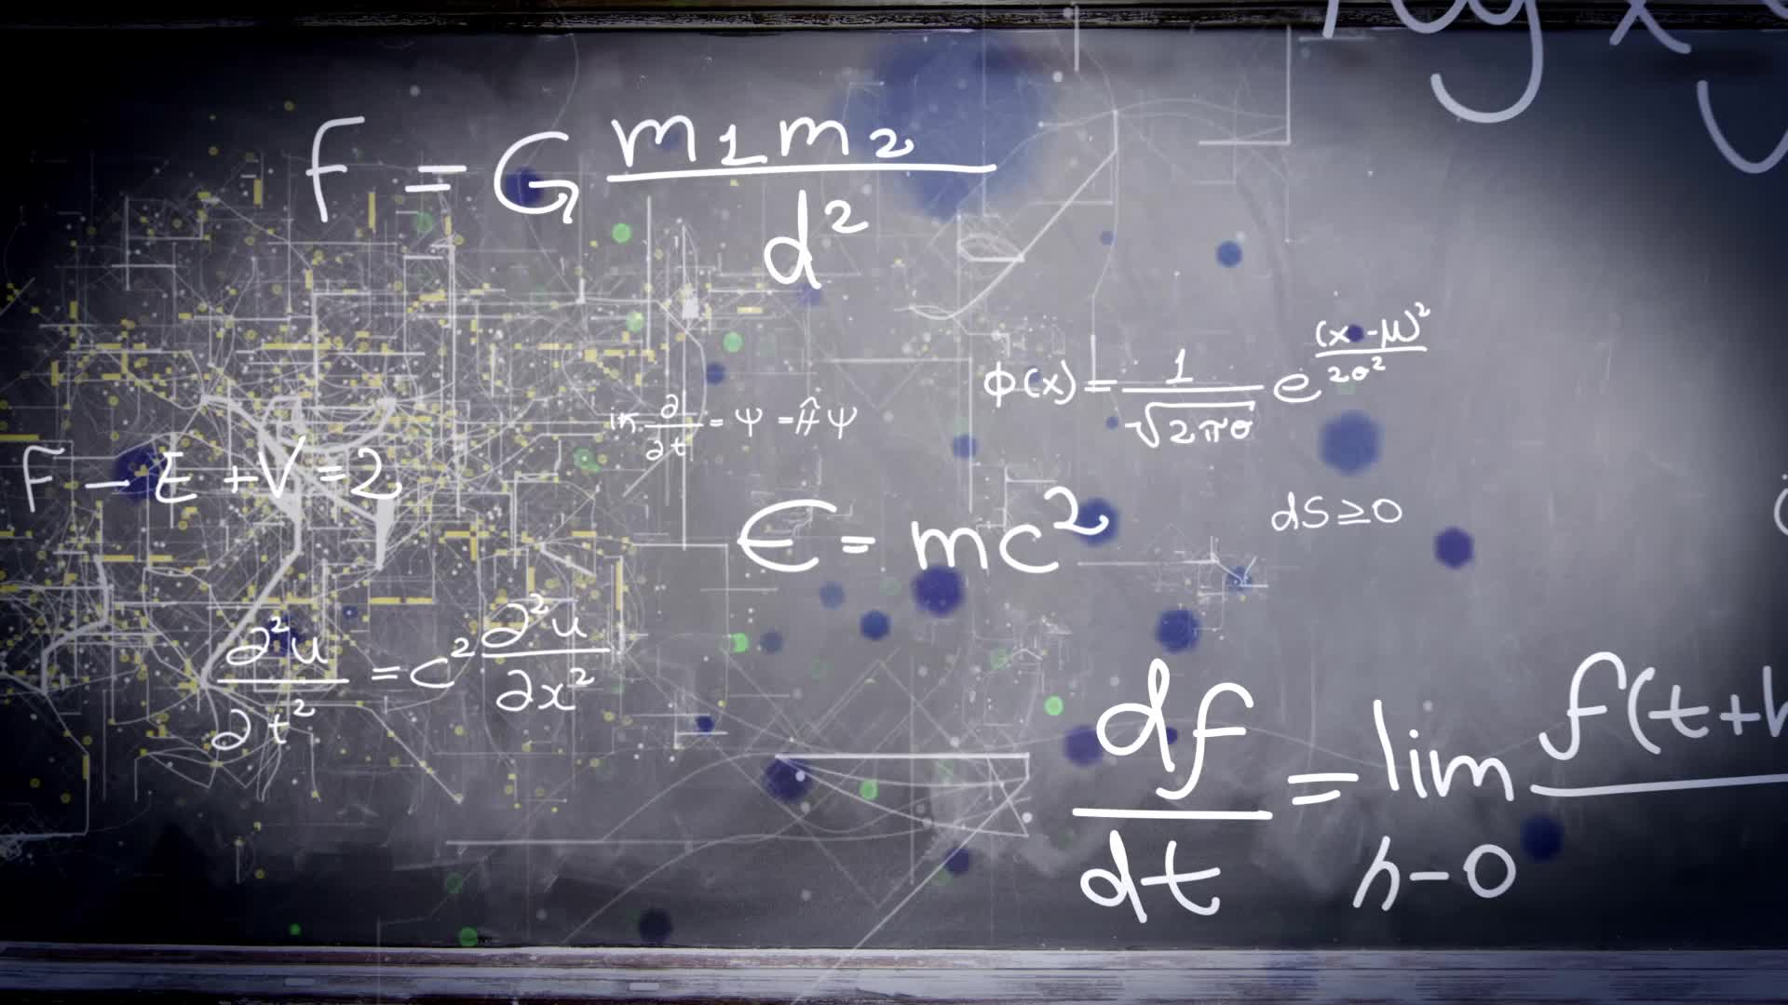
Method used in this PREDICTION models
Phase 2

Slide 52
K-Nearest Neighbor(KNN) Algorithm
K-Nearest Neighbour is one of the simplest Machine Learning algorithms based on Supervised Learning technique.
K-NN algorithm assumes the similarity between the new case/data and available cases and put the new case into the category that is most similar to the available categories.
K-NN algorithm stores all the available data and classifies a new data point based on the similarity. This means when new data appears then it can be easily classified into a well suite category by using K- NN algorithm.
K-NN algorithm can be used for Regression as well as for Classification but mostly it is used for the Classification problems.
K-NN is a non-parametric algorithm, which means it does not make any assumption on underlying data.
It is also called a lazy learner algorithm because it does not learn from the training set immediately instead it stores the dataset and at the time of classification, it performs an action on the dataset.
KNN algorithm at the training phase just stores the dataset and when it gets new data, then it classifies that data into a category that is much similar to the new data.

Slide 53
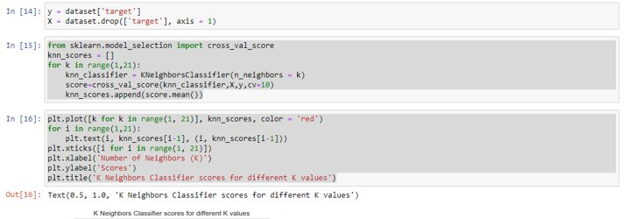
K-Nearest Neighbor(KNN) Algorithm APPLIED TO HEARTS DISEASE

Slide 54
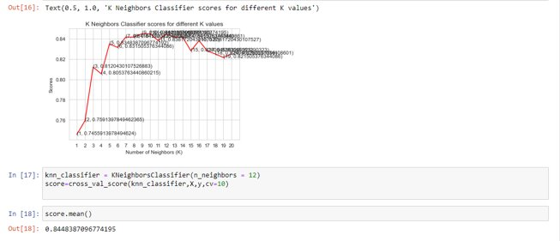
Final PREDICTION..

Slide 55

THANKYOU

